Slide 1

Tenth Sunday
of Ordinary Time
Notes:
Put this up before Mass until the Lector starts talking, then go to next slide.

Slide 2
A READING FrOM the
Book of genesis
3:9-15
Notes:
This and following for the first reading

Slide 3
After the man, Adam, had eaten of the tree, the LORD God called to the man and asked him, "Where are you?" He answered, "I heard you in the garden; but I was afraid, because I was naked, so I hid myself." Then he asked, "Who told you that you were naked? You have eaten, then, from the tree of which I had forbidden you to eat!" The man replied, "The woman whom you put here with me—she gave me fruit from the tree, and so I ate it." The LORD God then asked the woman, "Why did you do such a thing?" The woman answered, "The serpent tricked me into it, so I ate it."

Slide 4
Then the LORD God said to the serpent:
"Because you have done this, you shall be banned from all the animals and from all the wild creatures; on your belly shall you crawl, and dirt shall you eat all the days of your life. I will put enmity between you and the woman, and between your offspring and hers; he will strike at your head, while you strike at his heel."

Slide 5
The word of the Lord.
Thanks be to God.

Slide 6
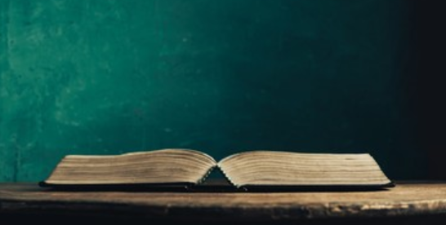
Notes:
Filler between 1st Reading and Responsorial Psalm.

Slide 7
RESPONSORIAL PSALM
Psalm 130:1-2. 3-4, 5-6, 7-8
V:
With the Lord there is mercy, and fullness of redemption.
R:
With the Lord there is mercy, and fullness of redemption.
Notes:
This and following for Responsorial Psalm.

Slide 8
Out of the depths I cry to you, O LORD; LORD, hear my voice! Let your ears be attentive to my voice in supplication.
R:
With the Lord there is mercy, and fullness of redemption.

Slide 9
If you, O LORD, mark iniquities, LORD, who can stand? But with you is forgiveness, that you may be revered.
R:
With the Lord there is mercy, and fullness of redemption.

Slide 10
I trust in the LORD; my soul trusts in his word. More than sentinels wait for the dawn, let Israel wait for the LORD.
R:
With the Lord there is mercy, and fullness of redemption.

Slide 11
For with the LORD is kindness and with him is plenteous redemption and he will redeem Israel from all their iniquities.
R:
With the Lord there is mercy, and fullness of redemption.

Slide 12
Notes:
Filler between Responsorial Psalm and 2nd Reading.

Slide 13
A READING FrOM the second letter
Of st. paul to the corinthians
4:1-5:1
Notes:
This and following for 2nd reading.

Slide 14
Brothers and sisters: Since we have the same spirit of faith, according to what is written, I believed, therefore I spoke, we too believe and therefore we speak, knowing that the one who raised the Lord Jesus will raise us also with Jesus and place us with you in his presence. Everything indeed is for you, so that the grace bestowed in abundance on more and more people may cause the thanksgiving to overflow for the glory of God. Therefore, we are not discouraged; rather, although our outer self is wasting away, our inner self is being renewed day by day. For this momentary light affliction is producing for us an eternal weight of glory beyond all comparison, as we look not to what is seen but to what

Slide 15
is unseen; for what is seen is transitory, but what is unseen is eternal. For we know that if our earthly dwelling, a tent, should be destroyed, we have a building from God, a dwelling not made with hands, eternal in heaven.

Slide 16
The word of the Lord.
Thanks be to God.

Slide 17
Notes:
Filler between 2nd Reading and Gospel Acclamation

Slide 18
GOSPEL Acclamation
All (2x): Alleluia, alleluia, alleluia
Cantor:
Now the ruler of the world will be driven out, says the Lord; and when I am lifted up from the earth, I will draw everyone to myself.
All (2x): Alleluia, alleluia, alleluia
Notes:
Gospel Acclamation (alleluia)

Slide 19
Notes:
Filler between Gospel Acclamation (alleluia) and Gospel.

Slide 20
A Reading from the holy gospel
according to mark
3:20-35
Notes:
This and following for Gospel.

Slide 21
Jesus came home with his disciples. Again the crowd gathered, making it impossible for them even to eat. When his relatives heard of this they set out to seize him, for they said, "He is out of his mind." The scribes who had come from Jerusalem said, "He is possessed by Beelzebul," and "By the prince of demons he drives out demons." Summoning them, he began to speak to them in parables, "How can Satan drive out Satan? If a kingdom is divided against itself, that kingdom cannot stand. And if a house is divided against itself, that house will not be able to stand. And if Satan has risen up against himself and is divided, he cannot stand; that is the end

Slide 22
of him. But no one can enter a strong man's house to plunder his property unless he first ties up the strong man. Then he can plunder the house. Amen, I say to you, all sins and all blasphemies that people utter will be forgiven them. But whoever blasphemes against the Holy Spirit will never have forgiveness, but is guilty of an everlasting sin." For they had said, "He has an unclean spirit." His mother and his brothers arrived. Standing outside they sent word to him and called him. A crowd seated around him told him, "Your mother and your brothers and your sisters are outside asking for you." But he said

Slide 23
to them in reply, "Who are my mother and my brothers?" And looking around at those seated in the circle he said, "Here are my mother and my brothers. For whoever does the will of God is my brother and sister and mother."

Slide 24
The Gospel of the Lord.
Praise to you Lord, Jesus Christ.

Slide 25

Notes:
For homily.

Slide 26

On Father’s Day, June 16th, parishes throughout the Diocese of San Bernardino will make an appeal for the forty-two retired priests who have served the diocese faithfully. Your generosity to this appeal helps to continue building the endowment fund to provide for future needs to support the retired priests! Thank you.

Slide 27
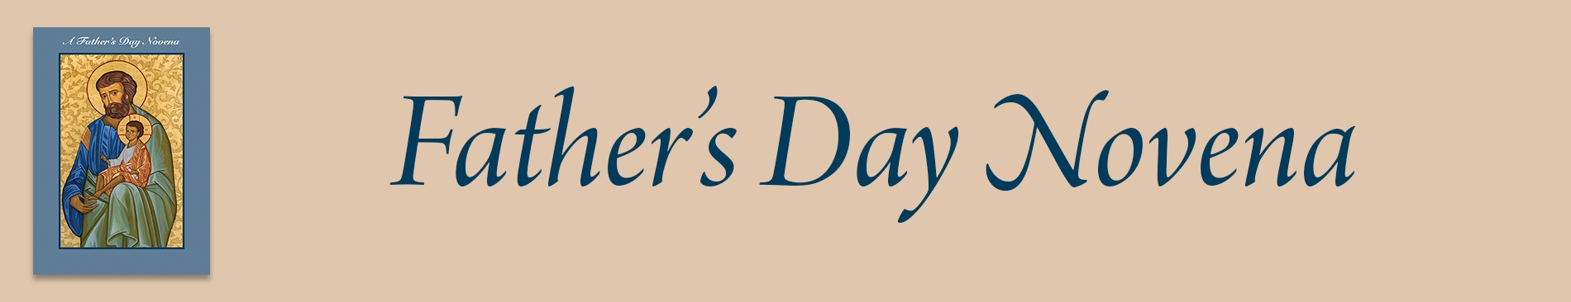
Give a gift of spiritual blessings by enrolling your father, grandfather, godfather, husband, or any father in your life, whether living or deceased in the Father’s Day Novena of Masses. They will be remembered at the altar as we celebrate Mass for their intentions for nine consecutive days beginning on Monday, June 17.

Slide 28
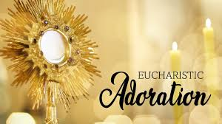
Come, Receive the Holy Spirit! Join us on Thursday, June 18 for Eucharistic Adoration of the Blessed Sacrament at 4:30PM, 6PM Holy Mass, and 7PM Individual Healing by Fr. Mike Barry.

Slide 29

SEAS Youth Ministry will be having a CAR WASH FUNDRAISER, to support our youth in their efforts to fundraise for NCYC 2024, other activities, and future events, on Saturday, June 22, 2024 from 7:00am to 1pm at SEAS designated parking area. There will be a table at the courtyard where you can buy your ticket for $10. Bring the ticket on the day of the car wash and support our event.

Slide 30
